Slide 1
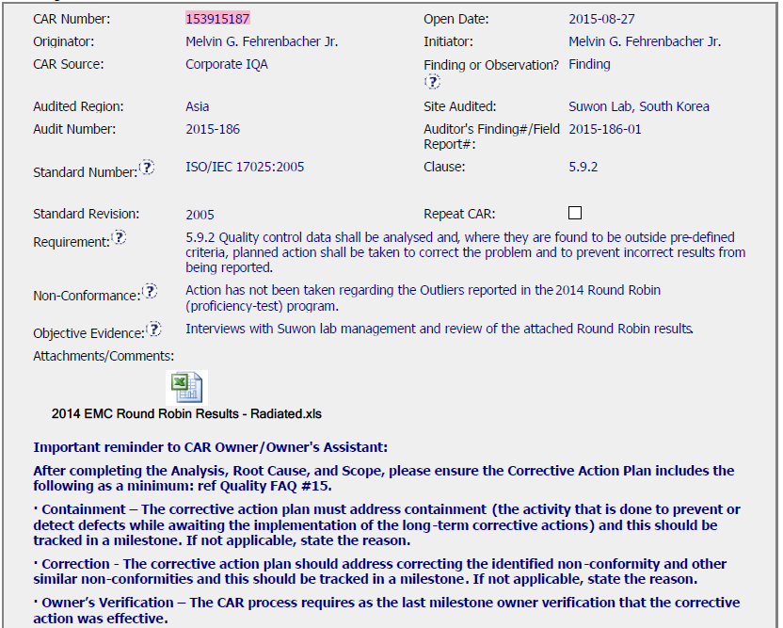
CAR 153915187

Slide 2
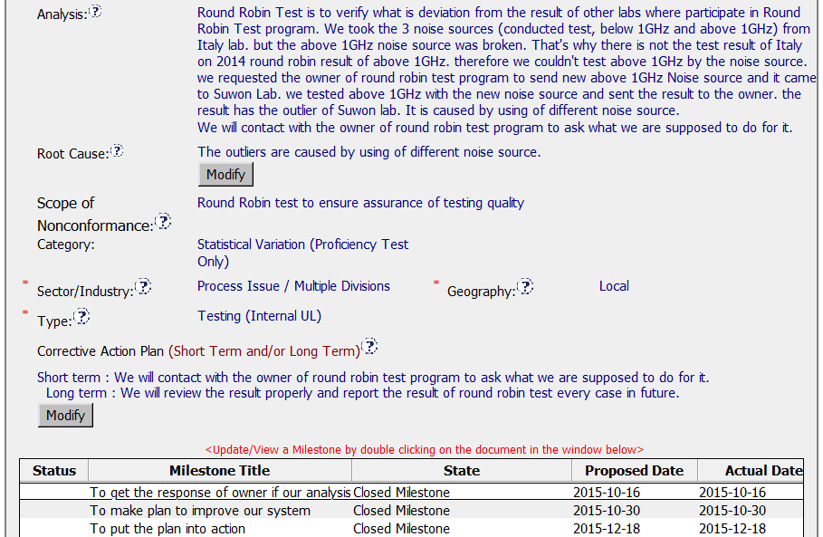
CAR 153915187
Need Improvement -
[Analysis] The Round Robin test result was issued on 2015-04-08. The analysis did not mention why the corrective actions were not taken when the outliers occurred during April to August 2015, it did not directly address the non-conformance. The statement in the Analysis field should be in another CAR (CAR Source: Proficiency Testing) for PT outlier action taken.
[Analysis] Lack of stakeholders involved and how widespread the nonconformance is.
[CAP] For Finding CAR, requires Containment and Owner’s verification milestones.

Slide 3
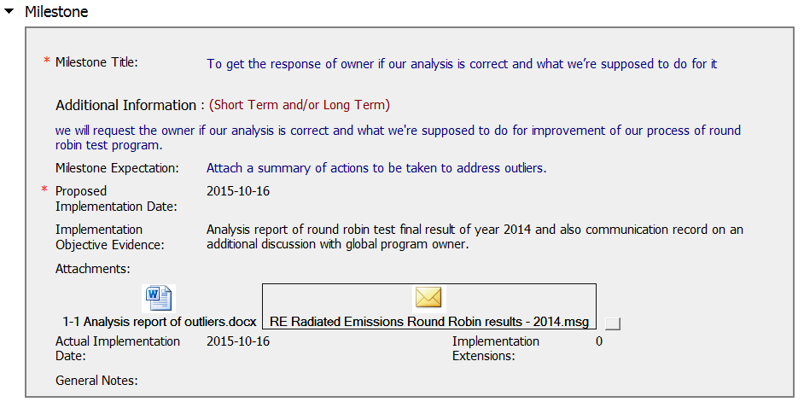
CAR 153915187
Need Improvement -
[Milestone] The content of Milestone should be in another CAR (CAR Source: Proficiency Testing) for this PT outlier action taken.

Slide 4
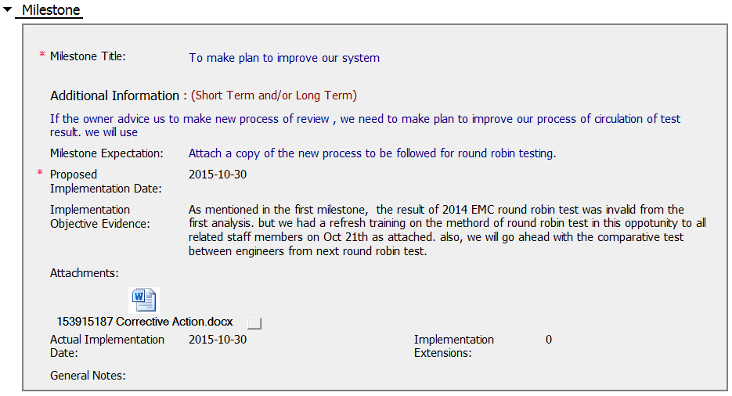
CAR 153915187
Excellent -
1. The attachment includes refresh training for this CAR, and new process identified for future round robin test.

Slide 5
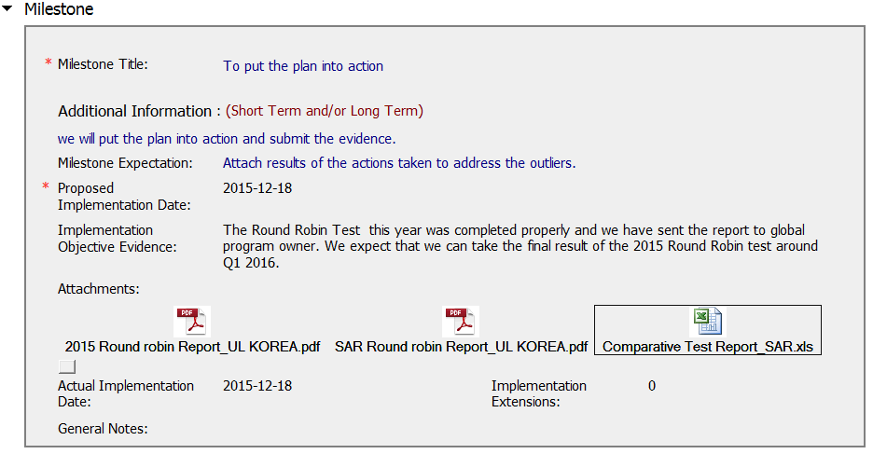
CAR 153915187

Slide 6
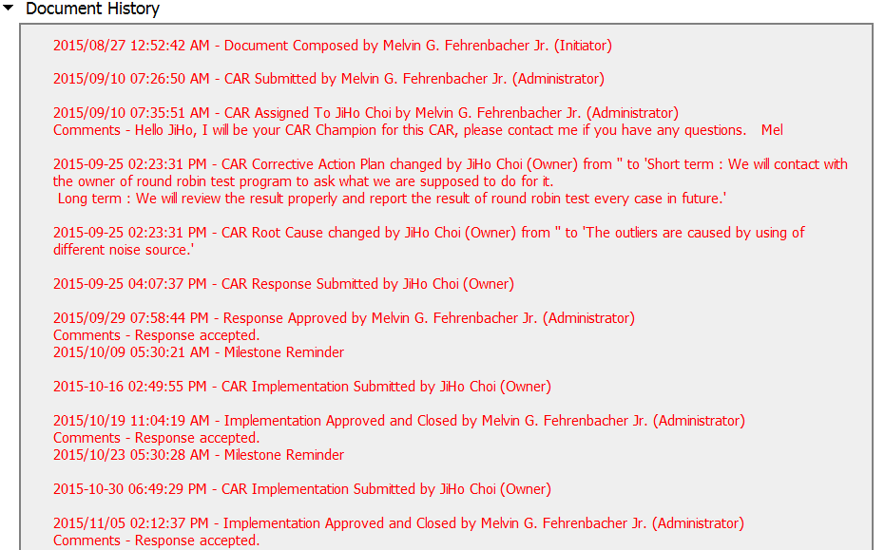
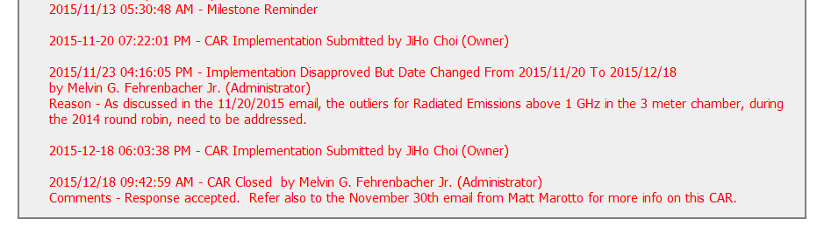
CAR 153915187
Excellent -
Acts on CARs within required timeframe and extensions are within 30 days.

Slide 7
CAR 153915187 – CBS Check
CBS Requirements | Excellent | Moderate | Need Improve | N/A
(C) Extensions are within requirement (<30 days, 3 or less) | √
(T) Most appropriate ‘category’, ‘type’, ‘geography’ are selected |  | √
(P) Facilitates the handling of disputed CARs |  |  |  | √
(T) Acts on CARs within required timeframe | √
(C) Analysis shows clear path to root cause and scope; stakeholders identified |  |  | √
(C) Root cause statement is succinct, reasonable, complete (Shows ‘N/A’ for observations) |  |  | √
(C) Corrective actions fix the objective evidence and other problems found; address entire root cause and scope. For observations, they do not go beyond fixing the objective evidence |  |  | √
(C) Milestones address containment & owner’s verification; completed per milestone expectations |  |  | √
(P) Verification per requirements |  |  |  | √
(L) Referenced communications are attached as needed | √
(C L) Evidence of communication for overdue/escalated CARs and other pertinent concerns |  |  |  | √
(P) Trains other CAR Champions |  |  |  | √

Slide 8
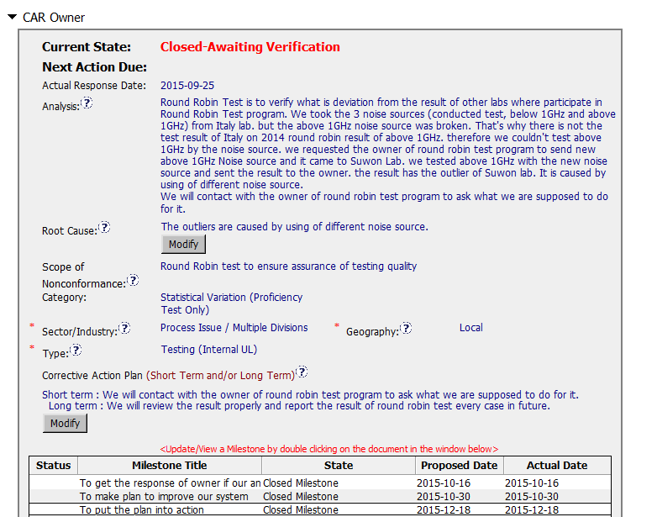
CAR 153915187
Analysis focused on containment vs. the lack of action on the outliers
Root Cause did not address the reason of ‘why action was not taken’
Although the required milestones were implemented, Milestone Titles did not correctly specify all the required stages.

Slide 9
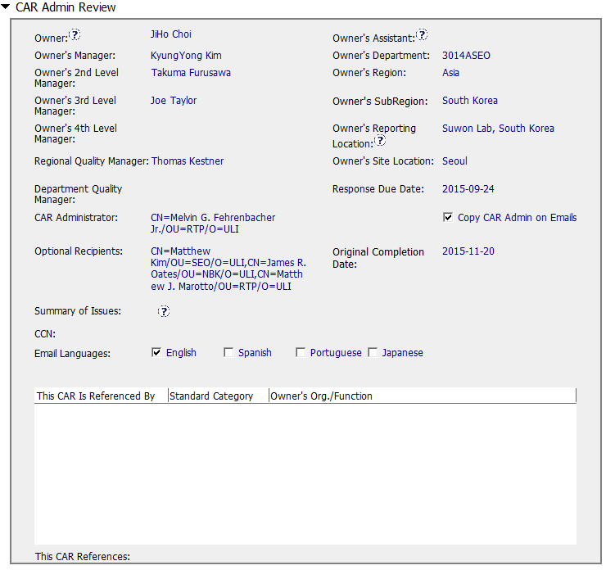
CAR 153915187
Correct Escalation Path

Slide 10

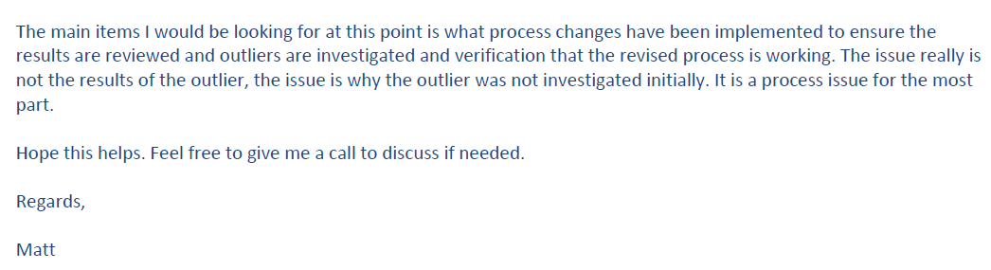
CAR 153915187
No evidence of follow-up on this email related to the CAR closure.

Slide 11
CAR 153915187
INTEGRITY
Initiative & Decision Making Analyzing & Problem Solving | Facilitates progression of the CAR through closure: extensions, escalations, reassignments, etc. NA Accurately completes the administrative fields within the CAR such as root cause category, process impacted, geography, etc. (T+) Acts on CARs within the required timeframe (T+) Facilitates the handling of disputed CARs NA (C) Extensions are within requirement (<30 days, 3 or less) (T) Most appropriate ‘category’, ‘type’, ‘geography’ are selected (P) Facilitates the handling of disputed CARs (T) Acts on CARs within required timeframe
COMPETITIVENESS
Customer Focus Achieve Business Results Flexibility | Assists customers as they address all aspects of the CAR – analysis, root cause statement, milestone, containment, verification, etc. (C-) Analysis & RC not complete Verifies CARs timely (P +) (C) Analysis shows clear path to root cause and scope; stakeholders identified (C) Root cause statement is succinct, reasonable, complete (Shows ‘N/A’ for observations) (C) Corrective actions fix the objective evidence and other problems found; address entire root cause and scope. For observations, they do not go beyond fixing the objective evidence (C) Milestones address containment & owner’s verification; completed per milestone expectations (P) Verification per requirements
COLLABORATION
Leading & Engaging Teamwork Communication | Provides pertinent feedback at appropriate times; shares information and keeps others informed (L+) Supports other CAR Champions by serving as their backup when they are absent NA Works as a team player with other CAR Champions NA (L) Referenced communications are attached as needed (C L) Evidence of communication for overdue/escalated CARs and other pertinent concerns (P) Trains other CAR Champions

